Slide 1
International study centre
An Introduction to object-orientation and software design
Name : John Alamina
Email : john.alamina@hud.ac.uk

Slide 2
Module Specification.
Module indicative content.
Assessments types: Logbook and in class tests.
How to fill logbooks.
draw.io for practical exercises
In class exercises.

Slide 3
Data Types in Object Oriented Programming
Data Types
Primitive
Integer
Character
Boolean
Floating point
Double floating point
Void
Wide Character
Derived
Array
Function
Pointer
Reference
User Defined
Class
Structure
Union
Enum
Typedef

Slide 4
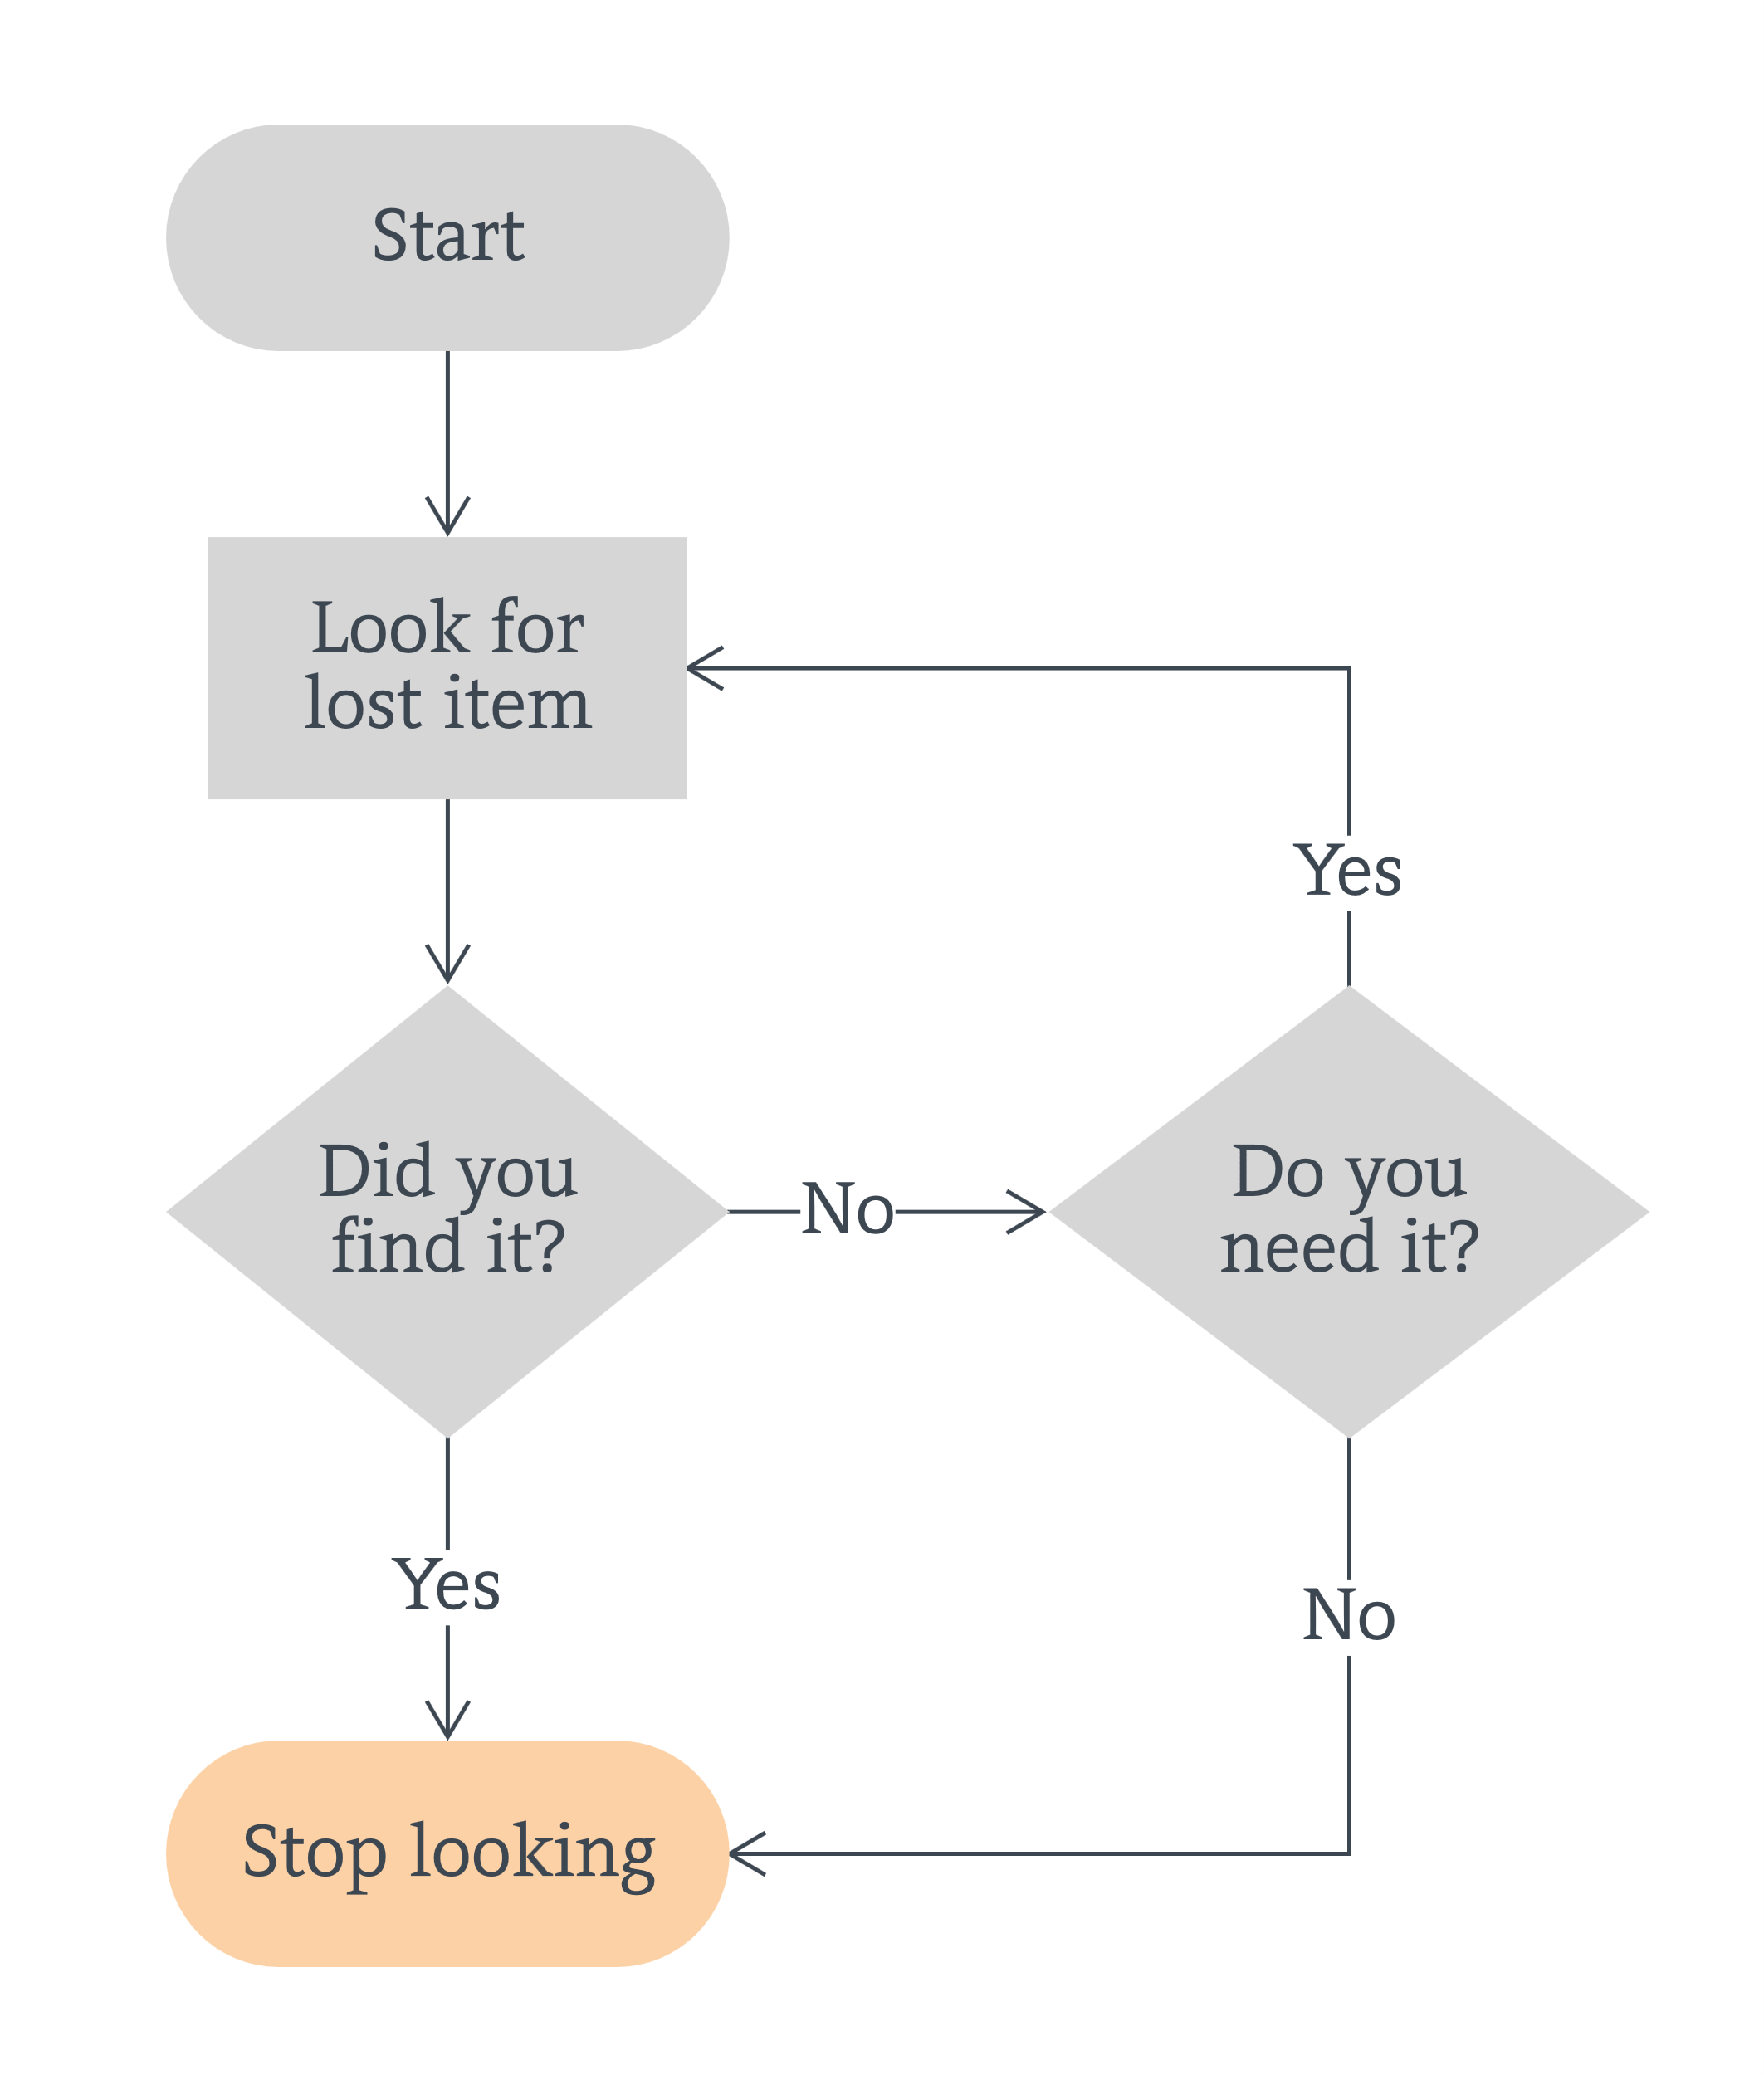
Flowcharts
Flowchart example
Task:
Go to www.draw.io
Click ‘Save diagrams to Device’
Create New diagram
Select ‘Flowchart’
Delete the displayed flowchart
Create a flowchart that asks user for login details, checks if the details are correct, grants access for correct details, denies access for incorrect details and blocks user after 3 unsuccessful attempts.

Slide 5
Software Design.
Software design is the process of transforming the customer requirements into a form implementable using a programming language.
This includes defining the classes, methods, functions, objects and the overall structure and interaction that will be translated into codes.
For object-oriented software, an object modelling language such as UML is used to develop and express the software design.
draw.io will be used in this class for object-oriented software modelling.

Slide 6
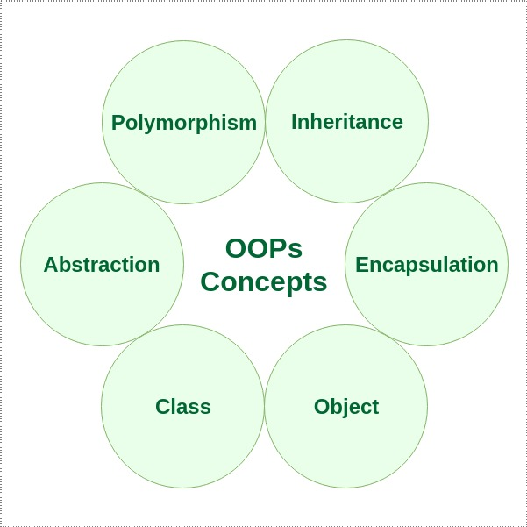
Object-Orientation.
Object-orientation is a software design concept which is used to build systems from a collection of reusable components called objects.
Objects contain data in the form of fields and functionality in the form of procedures. These are grouped together to represent an entity.
Object-oriented design involves defining the objects and their interactions to solve a problem.

Slide 7
Features of Object-oriented Designs.
Abstraction – The identification/description of the essential characteristics of an item.
Encapsulation – The grouping of related concepts into one item, such as a class or component
Inheritance – Inheritance enables new classes to receive the properties and methods of an existing class.
Polymorphism – The ability of different object to respond to the same message in different ways.

Slide 8
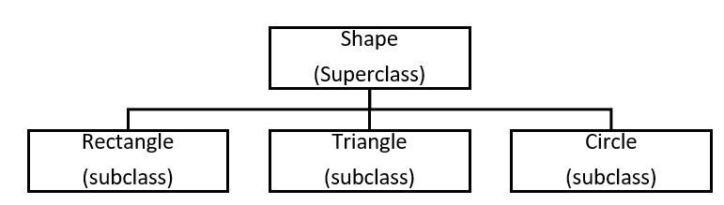
Terms Used in Object-oriented Design.
Object – A person, place, thing, event, concept, screen or report.
Class – A template from which objects are created, it is a software abstraction of a group of objects with common properties (Attributes), behaviour (operations).
Subclass – If class “B” inherits from class “A”, class “B” is a subclass of “A” and “A” is a superclass of “B”.
Abstract class – A class that does not have objects created from it.
Association – Relationship between objects.

Slide 9
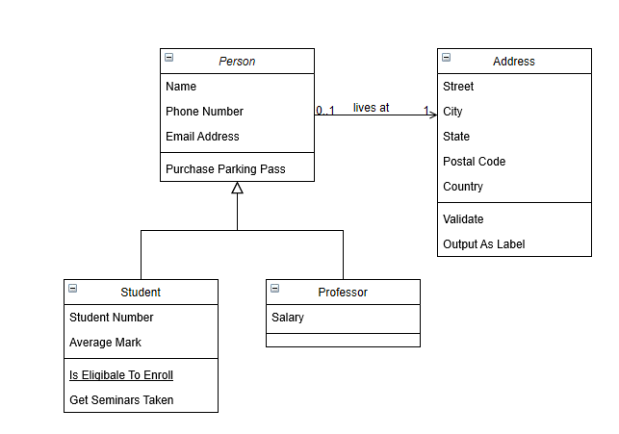
Unified Modeling Language (UML).
Go to www.draw.io >> choose “save diagrams to device” >> click “create new diagram” >> select “Class Diagram”.
The following example should be shown on your screen:

Slide 10
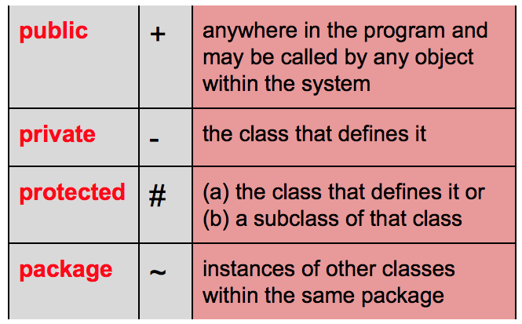
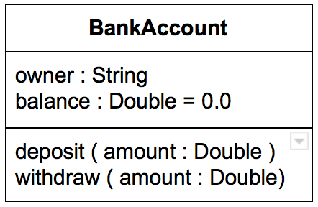
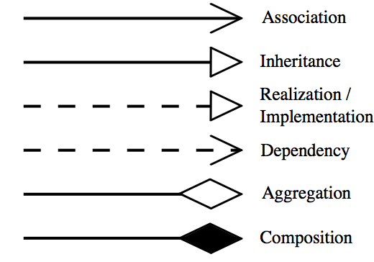
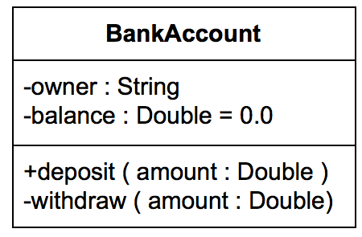
Representations in UML.
Visibility of class members
Class Representation
Class name
Class attributes
Class methods
Relationships

Slide 11
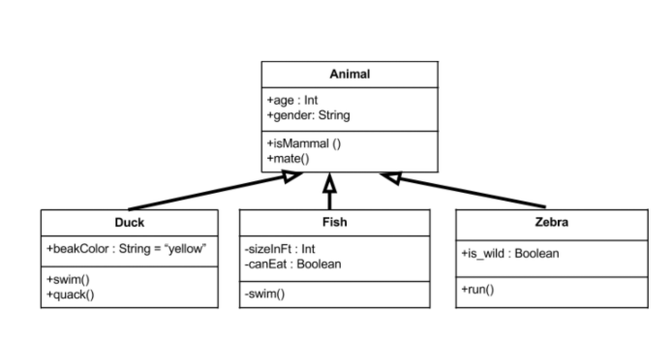
Class Diagram – Example.
Animal is the super class. Duck, Fish, and Zebra are subclasses and they inherit all the members from the superclass. The subclasses also have their own attributes and methods.

Slide 12
Drawing of Basic Class Diagram - Exercise
Create a class diagram representing the transport options available for moving from Manchester to London using draw draw.io.
It should include a superclass whose fields can be inherited by other classes.
Create three subclasses representing the means of transportation with their own unique fields in addition to those inherited from the superclass.
Ensure that class name, attributes, methods, visibility and relationship are covered in your diagram.
Final model should be submitted on Brightspace.

Slide 13
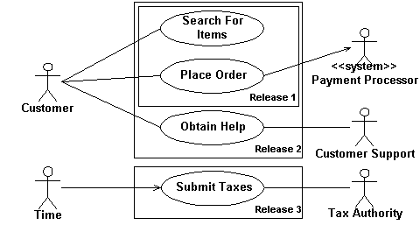
Use Case Diagrams
A UML use-case diagram is used to provide an overview of all or part of the usage requirements in the form of a model.
It shows the relationship among actors and use cases within a system.
An actor is a person, organization, local processes ( e.g. system clock), or external system that plays a role in one or more interactions with your system.
Actors are drawn as stick figures

Slide 14
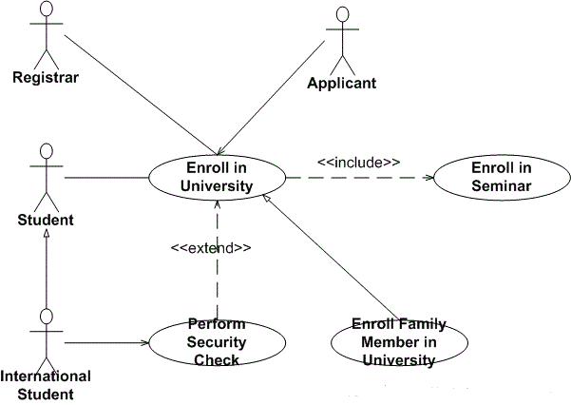
Use Case Diagrams – Relationship Guidelines
Solid lines are used when an actor supplies or receives information or initiates the use case
Used case description is represented in an oval.
Include is used to attach a smaller use case to a base use case, this makes them more manageable.
Extend is used when an optional use case is needed under certain conditions.
Include and extend are represented with dashed arrows.

Slide 15
Use Case Diagram – Exercise
Create a use case diagram on www.draw.io that represents students and teacher’s interaction with the Software Design Module Brightspace Page.
It should show the actors.
Think of a minimum of four use cases that involves at least one of the actors and include these in your diagram.
Think of one use case that involves two of the actors and represent this as well.

Slide 16
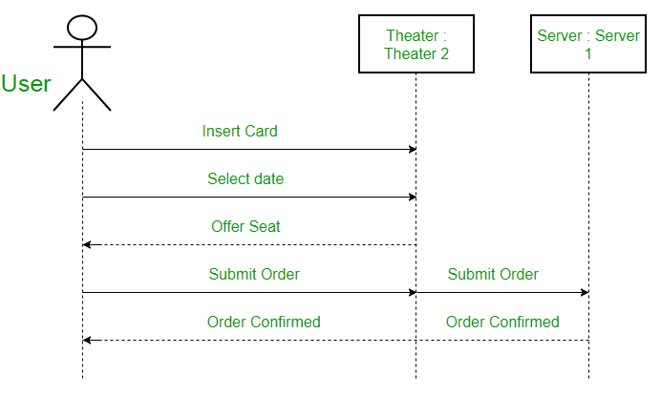
Sequence Diagrams
They depict interaction between objects in sequential order.
They are used for representing the logic and completeness of a usage scenario.

Slide 17
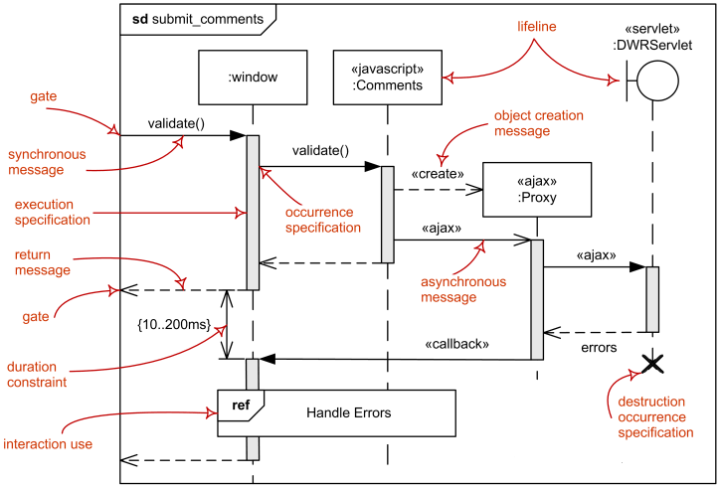
Terms Used in Sequence Diagrams

Slide 18
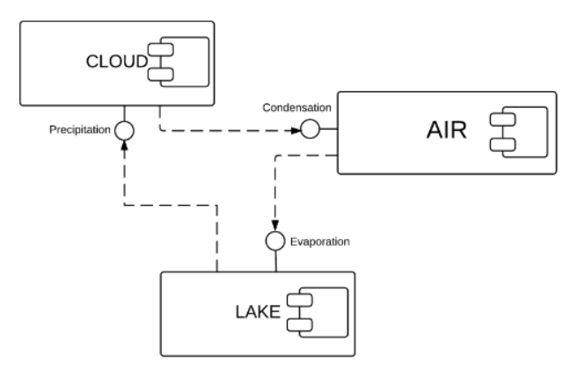
System Structure – Component Diagram
Component diagrams help us to understand the structure of existing systems and to build new ones.
They show the relationship between different components in a system.

Slide 19
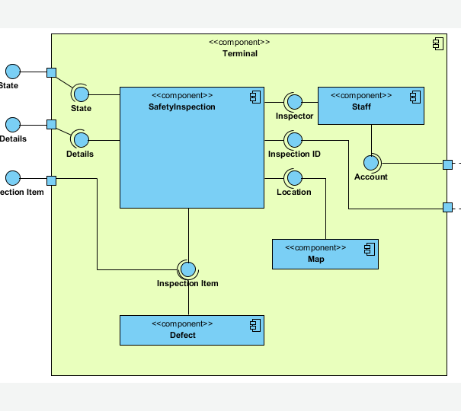
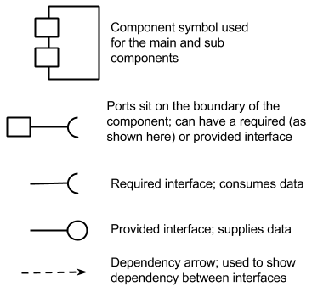
Component Diagram Shapes and Symbols

Slide 20
Any Questions?

